Slide 1

Recreational and Artisanal Fisheries
Dr Michael Smith & Dr Athol Whitten

Slide 2
Session Outline
Small-scale fisheries overview
Management challenges
Case studies

Slide 3
What is a small-scale fishery?
Most of the harvest is for local consumption or sale within the community
Usually harvest many different resources, mostly close to shore, many sedentary species
May involve isolated communities
Communities may have limited alternatives for food or employment

Slide 4
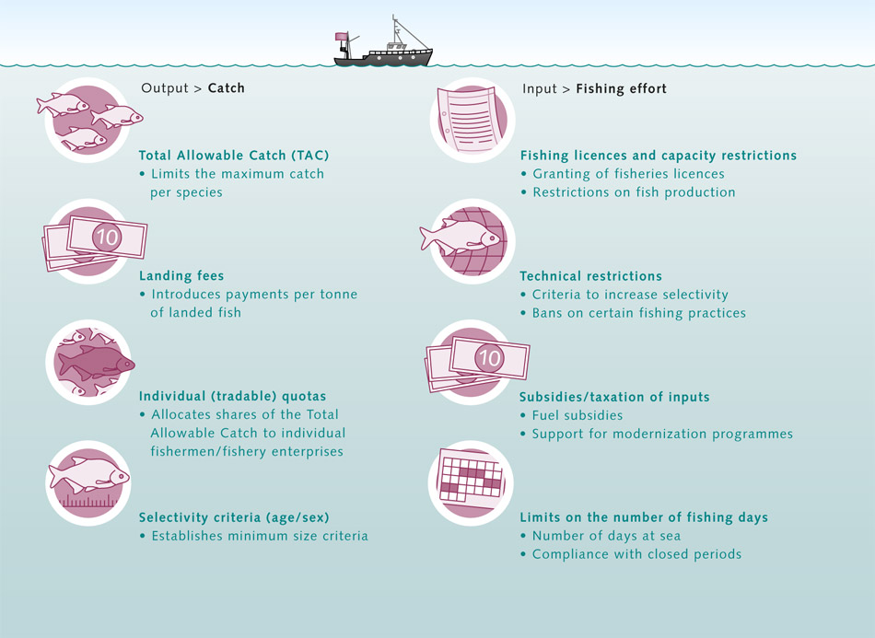








Fisheries management tools
Catch
Effort
Total Allowable Catch
(TAC) for the fishery
Landing fees
Individual quotas
(shares of the TAC)
Selectivity criteria
(age / size / sex)
Licences and restrictions
(access or capacity)
Technical restrictions
(gear or fishing practice)
Subsidies / taxation of inputs
(Fuel; support for modernisation)
Limit number of fishing days
(days at sea; closed periods)

Slide 5
Fisheries management tools
Catch
Effort
X
Total Allowable Catch
(TAC) for the fishery
Landing fees
Individual quotas
(shares of the TAC)
Selectivity criteria
(age / size / sex)
Licences and restrictions
(access or capacity)
Technical restrictions
(gear or fishing practice)
Subsidies / taxation of inputs
(Fuel; support for modernisation)
Limit number of fishing days
(days at sea; closed periods)
?
X
?
X

Slide 6
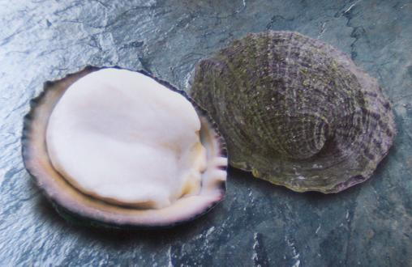
Case study: Chilean loco fishery
Carnivorous snail, eaten by local people for over 1000 years. Harvested by diving in shallow water or walking on the coast at low tide.
Pre-1974, small fishery for local consumption
In the 1970s, Chilean government policy changed to encourage exports, subsidies granted for boats and processing plants
Concholepas concholepas

Slide 7
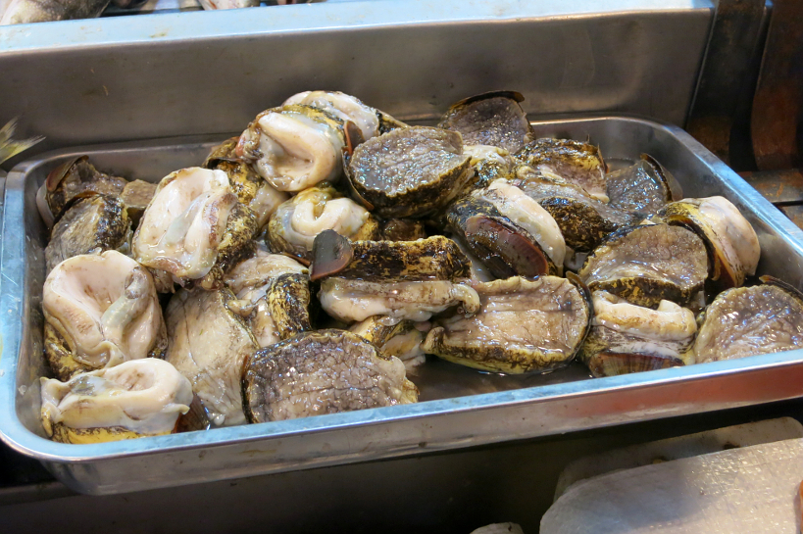
Case study: Chilean loco fishery
Prices grew rapidly, new markets were opened up (esp. in Asia), the catch grew 4-6x by 1980
Conflicts erupted, and the fishery declined through the 1980s
Traditional management measures failed, and the fishery was closed in 1989
Research clearly showed fishing caused the decline

Slide 8
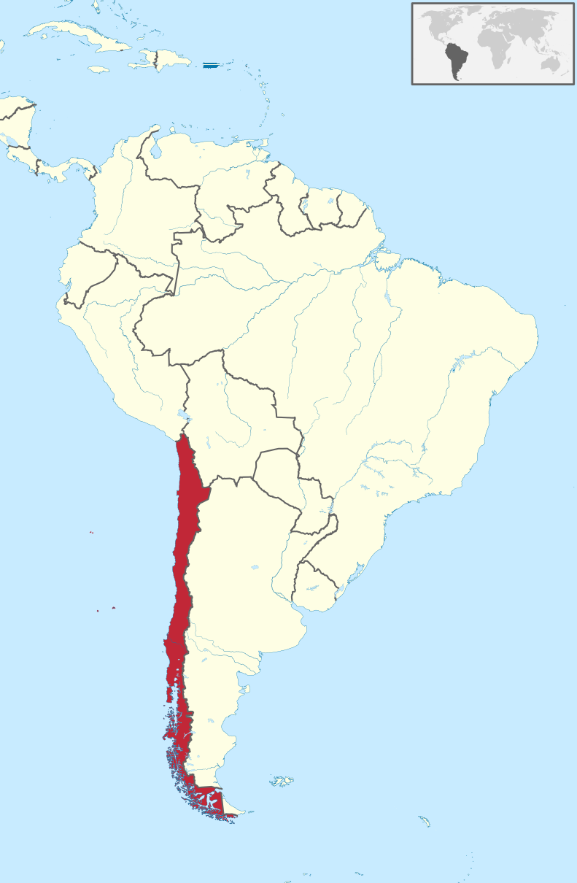
Case study: Chilean loco fishery
Along 4100km of coastline, Chile has 425 small fishing communities called caletas
Traditionally they sell to a local market, and only fish their local resources
May harvest over 20 types of fish and shellfish, but the loco was a major income
Other employment is hard to find

Slide 9
Case study: Chilean loco fishery
Chilean fisheries management was very “top-down”
Data collection, research, regulation, compliance, etc are all handled centrally
Top-down works well for a large-scale fishery with controlled access that targets a single stock
Chilean caletas are different:
Many access points, many different fleets
Many of the target species (e.g. loco) are sedentary
Biology (growth rates, size at maturity) vary regionally
Coastline is too long for effective management, monitoring, or enforcement

Slide 10
Case study: Chilean loco fishery
In 1991, Chile formed MEABRs (Management and Exploitation Areas for Benthic Resources)
Caletas could apply for exclusive access to harvest benthic resources on their coastline
Each can do their own resource inventory and make their own management plan
The central government evaluates these plans and monitors their implementation
Caletas also have the legal right to exclude any outsiders from fishing in their area

Slide 11
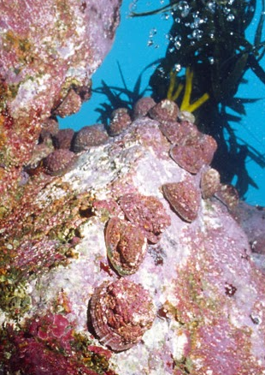
Case study: Chilean loco fishery
It works!
There are now 547 registered MEABRs, covering 103,000ha
Loco in the caleta areas are much more abundant
Overall harvest has increased, incomes have also increased
Caleta members feel empowered and in control of their own future

Slide 12
Artisanal fisheries: lessons
Controlled access is vital
Most common management tool is TURFs (Territorial Users Right to Fish)
Mostly useful for sedentary resources
Allow for data collection, management planning, and enforcement at very fine scales
Almost always community based (e.g. caletas)
Social and political leadership are needed

Slide 13
Group activity
Consider a recreational fishery that you are familiar with.
How is the fishery managed at present?
Identify what data are currently collected, and how the fishery is being assessed (if at all).
What are some other ways that the fishery could be managed?

Slide 14
www.mezo.com.au

